Slide 1
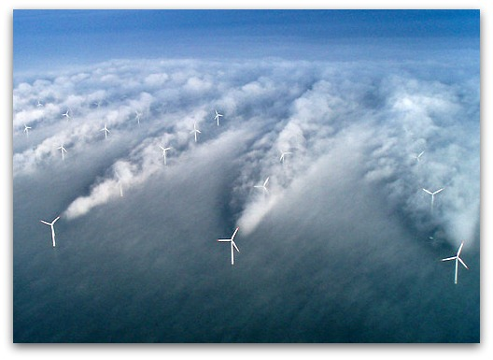
Why $𝒢_{a}=ℱ_{a}$
Urs Schaefer-Rolffs
Collaborators: Rahel Knöpfel and Erich Becker
100km
100 m
Cape Verde (http://visibleearth.nasa.gov)
Horns Rev, Denmark (Christian Steiness)

Slide 2
Overview
Motivation
The Scale Invariance Criterion
Modeling
Outlook

Slide 3
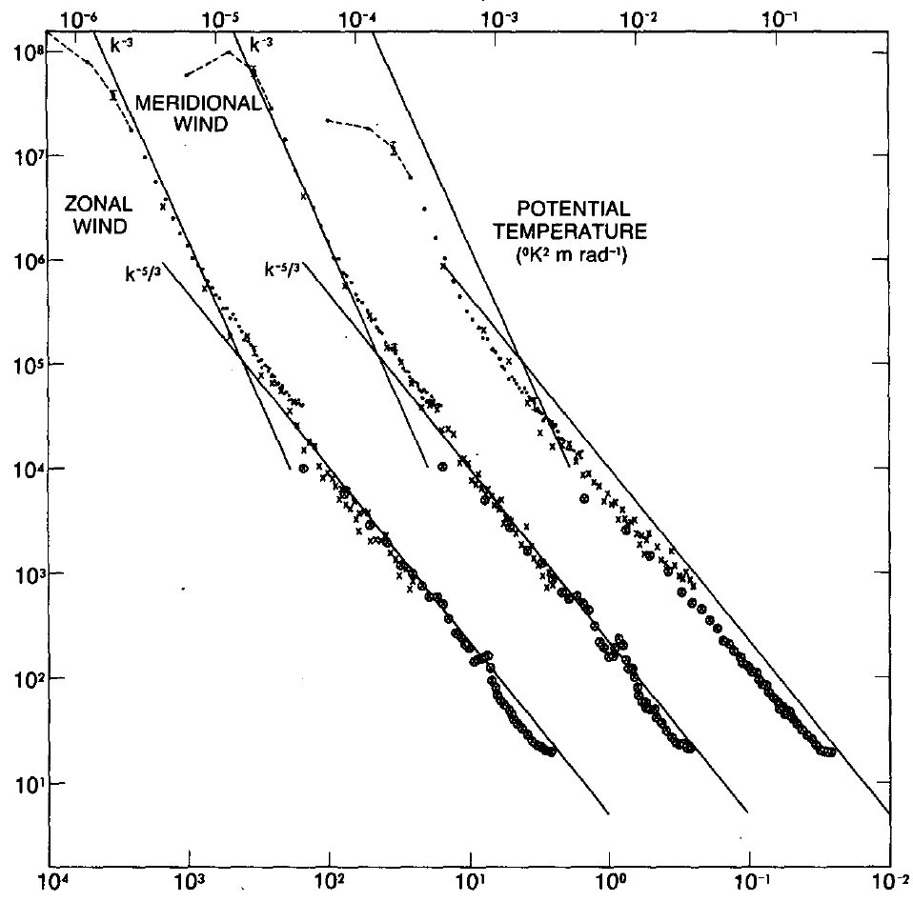
k⁻³
Motivation
k^{-5/3}
spectral density (a.u.)
ε = const. > 0
planetary scales
synoptic
scales
anisotropic inertial range
isotropic inertial range
viscous scales
10⁴
10³
10²
10¹
10⁰
10⁻¹
10⁻²
10⁻³
10⁻⁴
horizontal wavelength (km)
Aim: Better understanding of atmospheric energy cycle
Requirement: Consistence of the dynamical core and parameterizations for a correct description of energy transfer → Scale-invariant inertial range?
Investigation of scale invariance up to now only for isotropic, incompressible, and three-dimensional turbulence → Scale invariance in the real atmosphere?

Slide 4
Overview
Motivation
The Scale Invariance Criterion
Modeling
Outlook

Slide 5
The Scale Invariance Criterion
$$t^{∗}=e^{\frac{2}{3}c_{x}}t; x^{∗}=e^{c_{x}}x; v^{∗}=e^{\frac{1}{3}c_{x}}v; a^{∗}=e^{c_{a}}a; {b_{i}}^{∗}=e^{c_{b_{i}}}b_{i}$$
$$∂_{t}a+\left(v⋅∇\right)a=ℱ_{a}\left(t,x,a,b_{i}\right)$$
$$∂_{t^{∗}}a^{∗}+\left(v^{∗}⋅∇^{∗}\right)a^{∗}=ℱ_{a}\left(t^{∗},x^{∗},a^{∗},{b_{i}}^{∗}\right)$$
$$∂_{t}a+\left(v⋅∇\right)a=e^{\frac{2}{3}c_{x}−c_{a}}ℱ_{a}\left(e^{\frac{2}{3}c_{x}}t,e^{c_{x}}x,e^{c_{a}}a,e^{c_{b_{i}}}b_{i}\right)≡𝒢_{a}\left(t,x,a,b_{i}\right)$$
$$𝒢_{a}\left(t,x,a,b_{i}\right)≝ℱ_{a}\left(t,x,a,b_{i}\right)$$
$$y=φ\left(y^{∗},z^{∗}\right), z=ψ\left(y^{∗},z^{∗}\right)$$
$$e^{c_{a}−\frac{2}{3}c_{x}}∂_{t}a+e^{c_{a}−\frac{2}{3}c_{x}}\left(v⋅∇\right)a=ℱ_{a}\left(e^{\frac{2}{3}c_{x}}t,e^{c_{x}}x,e^{c_{a}}a,e^{c_{b_{i}}}b_{i}\right)$$
Fast check for consistence: Scale invariance criterion (Schaefer-Rolffs et al., 2015)
Each term in a given equation of motion can be investigated separately
Constraints for scale-invariant formulation of parameterization
Scale invariance of the model equations within a finite range of scales is preserved if the source function fulfills
Hence, a specific relation between the scaling factors exist in the regime of scale invariance.
$$𝒢_{a}\left(t,x,a,b_{i}\right)≝ℱ_{a}\left(t,x,a,b_{i}\right)$$

Slide 6
The Scale Invariance Criterion
Example 2: Dynamic Smagorinsky Model ($K_{h}={l_{h}}^{2}\left|S_{h}\right|$, $l_{h}≠const.$)
$$a=v; 𝓕_{v}=∇\left({l_{h}}^{2}\left|S_{h}\right|S_{h}\right); c_{l_{h}}=c_{x}; c_{S_{h}}=−\frac{2}{3}c_{x}$$
$$𝓖_{v}=e^{\frac{2}{3}c_{x}−\frac{1}{3}c_{x}}e^{−c_{x}}∇\left({{e^{2c_{x}}l}_{h}}^{2}e^{2⋅\frac{2}{3}c_{x}}\left|S_{h}\right|S_{h}\right)=∇\left({l_{h}}^{2}\left|S_{h}\right|S_{h}\right)=𝓕_{v}$$
Example 1: Classical Smagorinsky model ($K_{h}={l_{h}}^{2}\left|S_{h}\right|$, $l_{h}=const.$)
$$a=v; 𝓕_{v}={l_{h}}^{2}∇\left(\left|S_{h}\right|S_{h}\right); c_{l_{h}}=0; c_{S_{h}}=−c_{t}=−\frac{2}{3}c_{x}$$
$$𝓖_{v}=e^{\frac{2}{3}c_{x}−\frac{1}{3}c_{x}}{l_{h}}^{2}e^{−c_{x}}∇\left(e^{2⋅\frac{2}{3}c_{x}}\left|S_{h}\right|S_{h}\right)=e^{−2c_{x}}{l_{h}}^{2}∇\left(\left|S_{h}\right|S_{h}\right)≠𝓕_{v}$$
Example 3: Vertical diffusion of horizontal momentum ($K_{z}={l_{z}}^{2}\left|∂_{z}v\right|$, $ρ=const.$)
$$a=v; 𝓕_{v}=∂_{z}\left({l_{z}}^{2}\left|∂_{z}v\right|∂_{z}v\right); c_{l_{z}}=?$$
$𝓖_{v}=e^{\frac{1}{3}c_{x}}{e^{−c_{z}}∂}_{z}\left(e^{2c_{l_{z}}}{l_{z}}^{2}e^{2(\frac{1}{3}c_{x}−c_{z})}\left|∂_{z}v\right|∂_{z}v\right)$ .
$=e^{2c_{l_{z}}−(3c_{z}−c_{x})}∂_{z}\left({l_{z}}^{2}\left|∂_{z}v\right|∂_{z}v\right)=𝓕_{v}→ c_{l_{z}}=\frac{3c_{z}−c_{x}}{2}$
With $c_{z}=\frac{2}{3}c_{x}$ for large scales → $c_{l_{z}}=\frac{1}{2}c_{x}=\frac{1}{2}c_{l_{h}}$ → $l_{z}=\sqrt{𝒞_{z}l_{h}}$
$$!$$

Slide 7
Overview
Motivation
The Scale Invariance Criterion
Modeling
Outlook

Slide 8
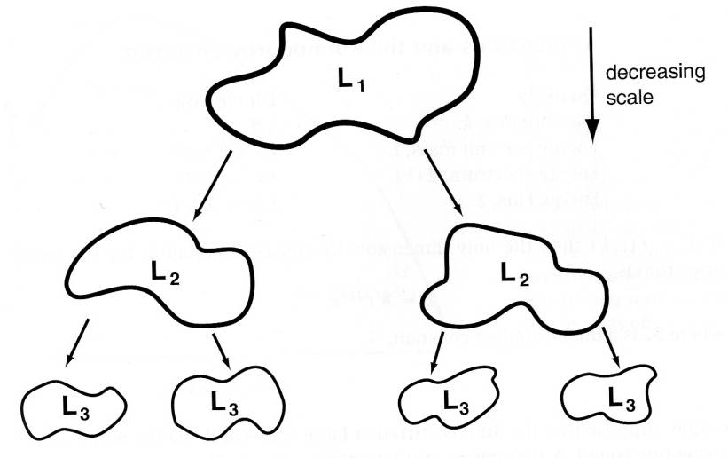
Modeling
n_{a}
n_{b}
n_{a}
n_{b}
n_{c}
n_{d}
n_{a}
n_{b}
n_{c}
n_{d}
Dynamic Smagorinksy Model (DSM): Spectra with ${−5}/3$ slope for the first time without hyperdiffusion (Schaefer-Rolffs and Becker, 2013)

Slide 9
Modeling
k⁻³
Test filter range
Resolution scale
k^{-5/3}
spectral density (a.u.)
planetary scales
synoptic scales
anisotropic inertial range
Isotropic inertial range
viscous scales
10⁴
10³
10²
10¹
10⁰
10⁻¹
10⁻²
10⁻³
10⁻⁴
horizontal wavelength (km)
Schematic of the nonlinear interaction near the resolution scale
Problem at resolution scale: Are scale interaction relevant?

Slide 10
Modeling
n_{a}
n_{b}
n_{a}
n_{b}
n_{c}
n_{d}
n_{a}
n_{b}
n_{c}
n_{d}
Dynamic Smagorinksy Model (DSM): Spectra with ${−5}/3$ slope for the first time without hyperdiffusion (Schaefer-Rolffs and Becker, 2013)

Slide 11
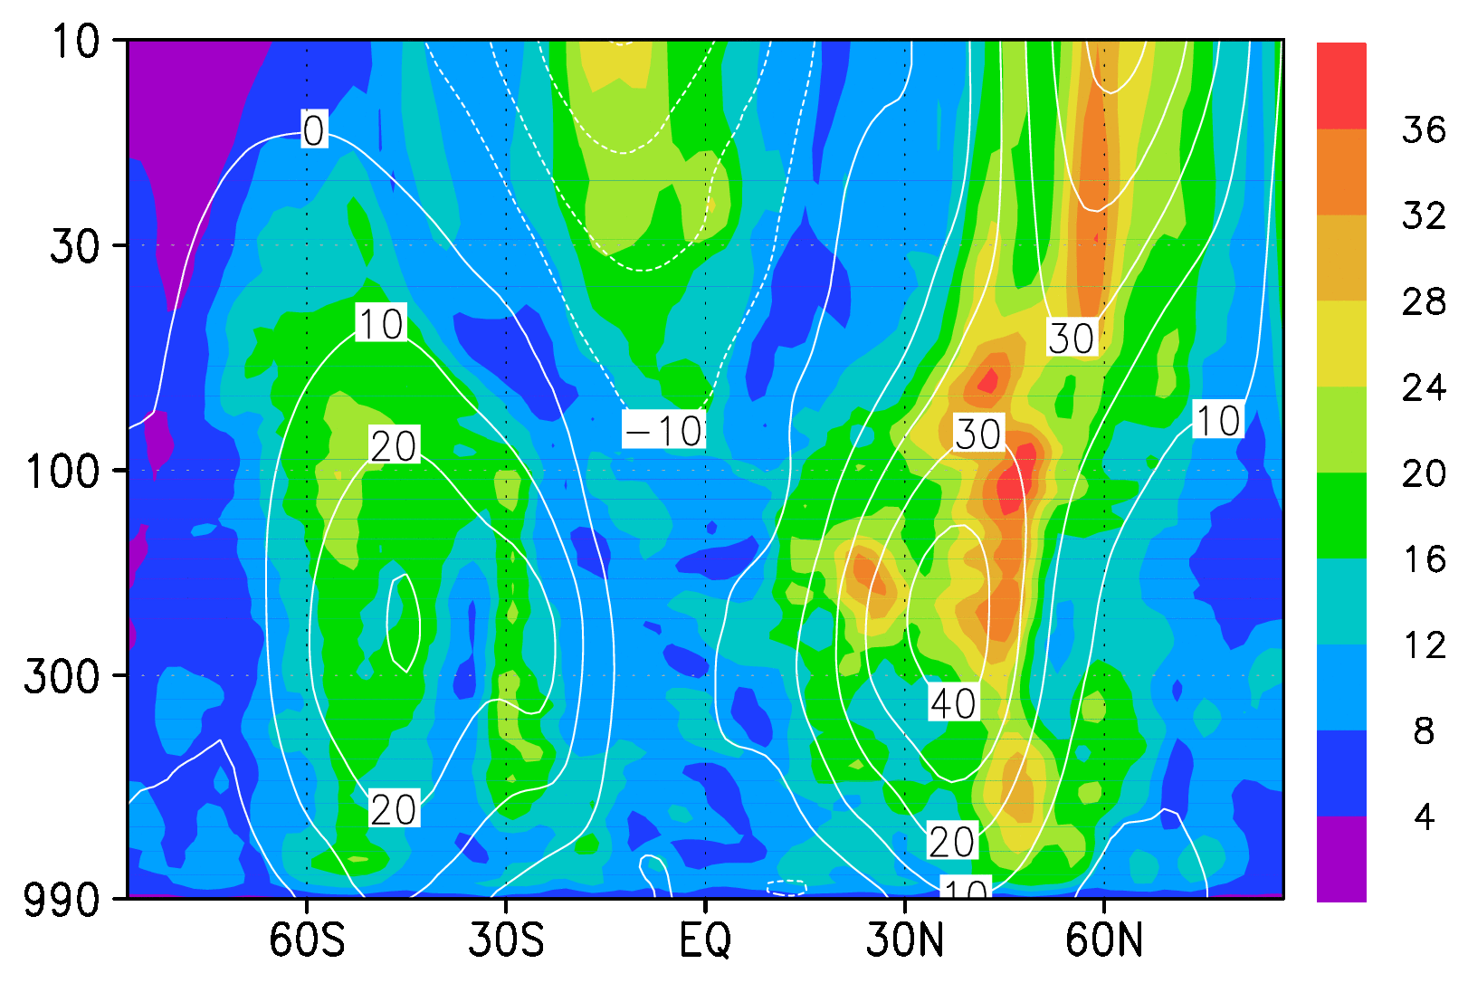
Modeling
Horizontal dynamical mixing length (km) and zonal wind (m/s)
pressure (mbar)
latitude
Solution: Generalized DSM with filtering at larger scales than the resolution scale (Schaefer-Rolffs and Becker, 2015)

Slide 12
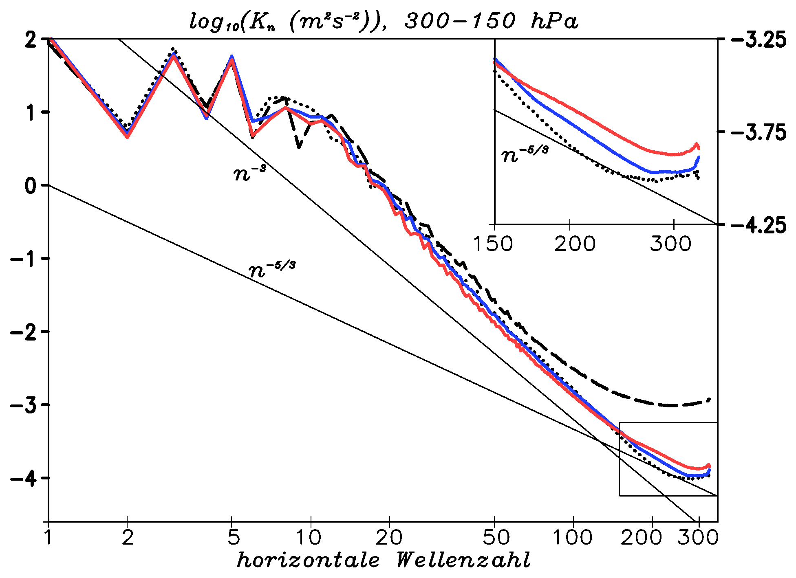
Modeling
HML and VML constant
HML dynamically, VML constant
HML and VML dynamically
horizontal wavenumber

Slide 13
Conclusions
Scale Invariance Criterion for fast check of consistence
Each term of equation can be checked separately
Constraints for new parametrizations
Generalized Dynamic Smagorinsky Model with test filter independent from resolution scale
Energy spectra with transition to ${−5}/3$ slope
$$𝒢_{a}\left(t,x,a,b_{i}\right)≝ℱ_{a}\left(t,x,a,b_{i}\right)$$

Slide 14
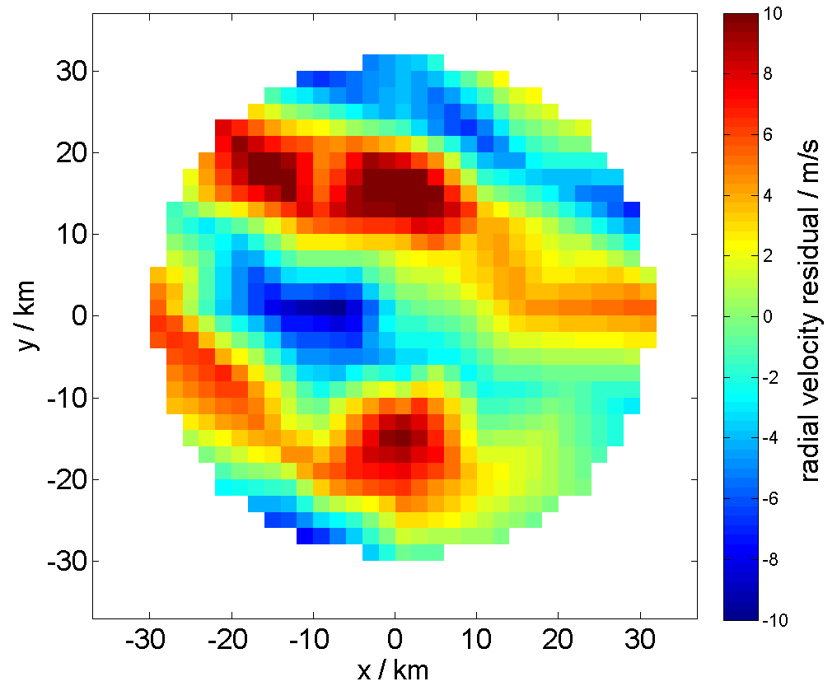
Outlook
Validation of the anisotropic scale ratio for the Primitive Equations
→ Compatibility with scale ratio of Stratified Turbulence, $Z/{X∼{ε^{1/3}X^{{−2}/3}}/N}$ (Lindborg, J. Fluid. Mech., 2006)
Investigation of the dynamical vertical mixing length → What is the relevance of $𝒞_{z}$?
(Necessary) improvement of the concept of the DSM according to thermodynamic equations of motion, implementation of dynamical tracers/moisture parameterizations in the KMCM
→ Dynamical mixing length for temperature/H₂O-concentration
→ Self-consistent determination of Prandtl/Schmidt number
Comparison with gravity wave (GW) spectra of the MLT from horizontal Radar and rocket measurements:

Slide 15
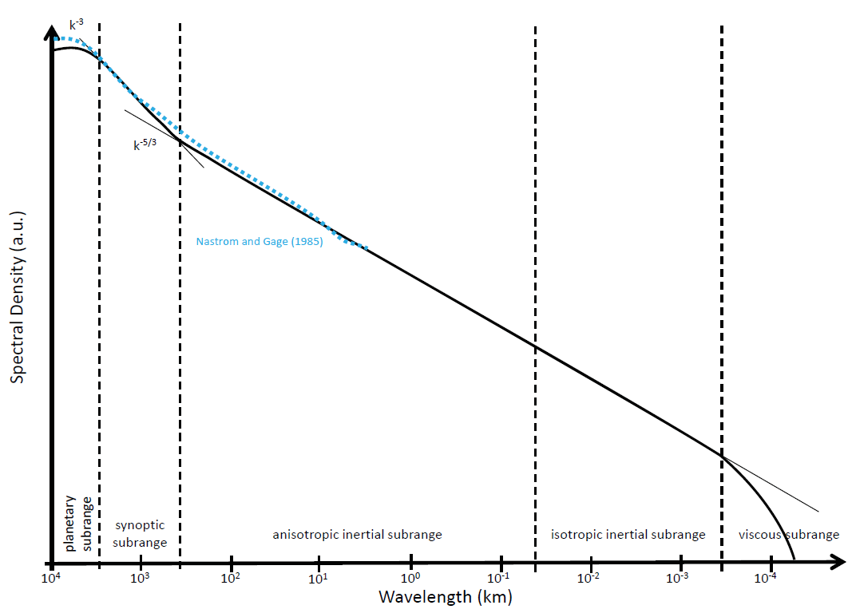
Scale invariance
Scale invariance: Objects or laws that do not change if scales of length, time, or other variables, are multiplied by a common factor λ
Lie group analysis: Euler equations possess two scaling symmetries, Navier-Stokes equations one scaling symmetry
Inertial range: energy transfer independent from outer scales → self similarity
Scale invariance of Euler equations within inertial range
Atmosphere: horizontal KE spectrum exhibitis -5/3 law at mesoscales after -3 law from enstrophy cascade at large scales
The resolution scale of the KMCM is denoted.

